Slide 1


AccuBet Ontario
By: Albert Sarpong & Shane D’Souza

Slide 2
Project Objective
Create the back-end infrastructure for a future website
A user will use our platform as an advisor when betting on EPL and NBA games

Slide 3
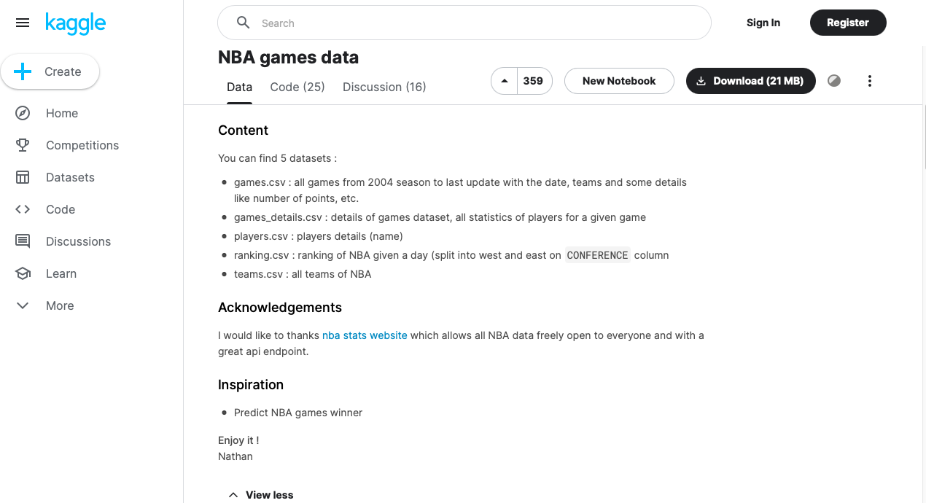
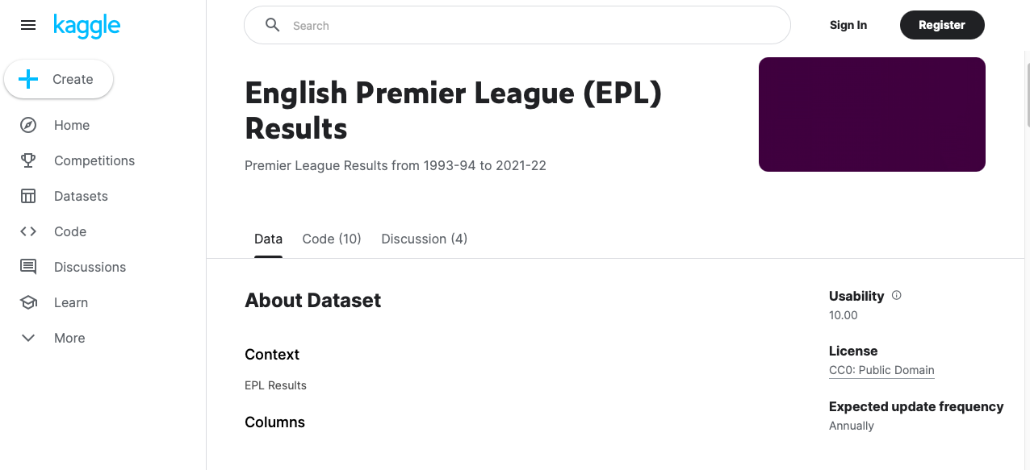
Obtaining Data
Data was obtained from Kaggle
Large datasets are available with a variety of data

Slide 4
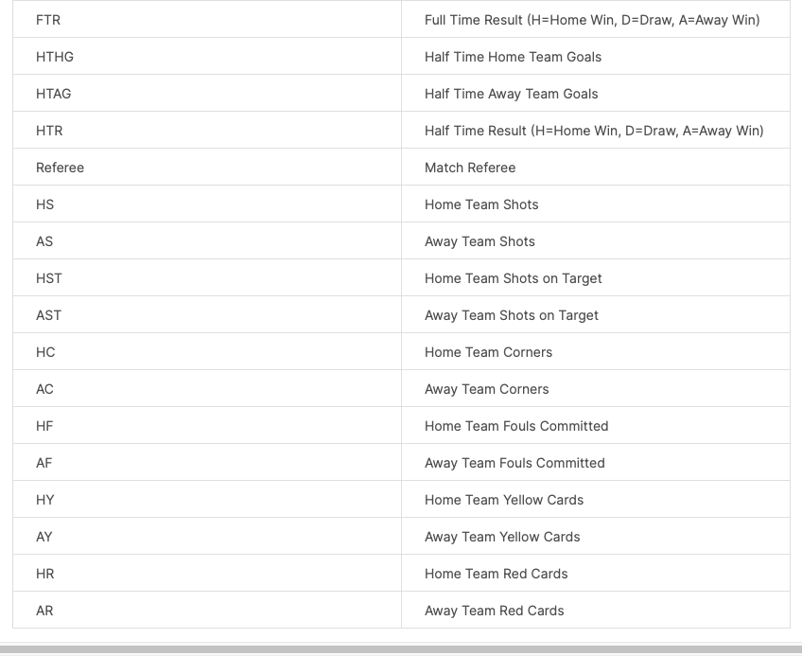
Data Preparation & Cleaning
All data was results of games completed, and using this data would provide extremely accurate results with heavy lookahead bias
I will go through the two notebooks to show cleaning methods

Slide 5
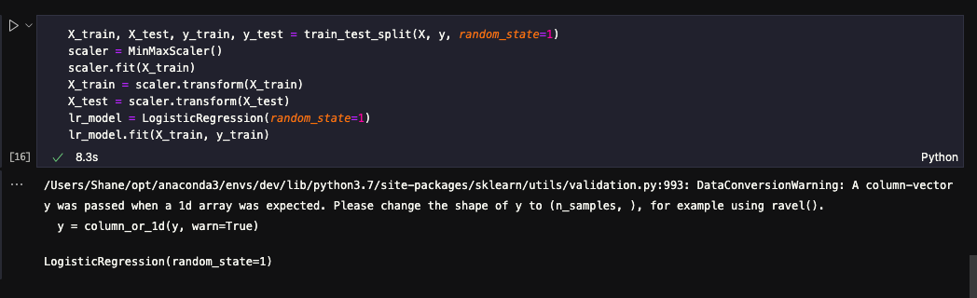
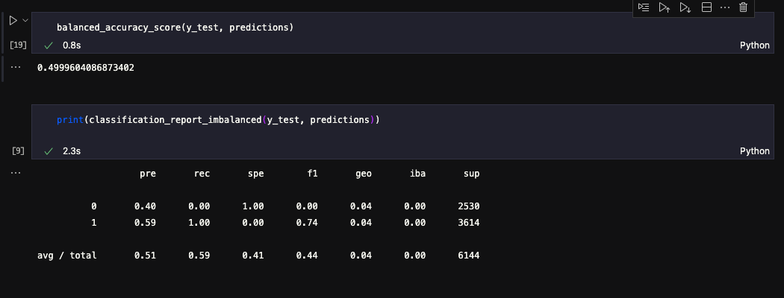
Machine Learning Models - NBA
For NBA, LogisticRegression and RandomForests were used

Slide 6
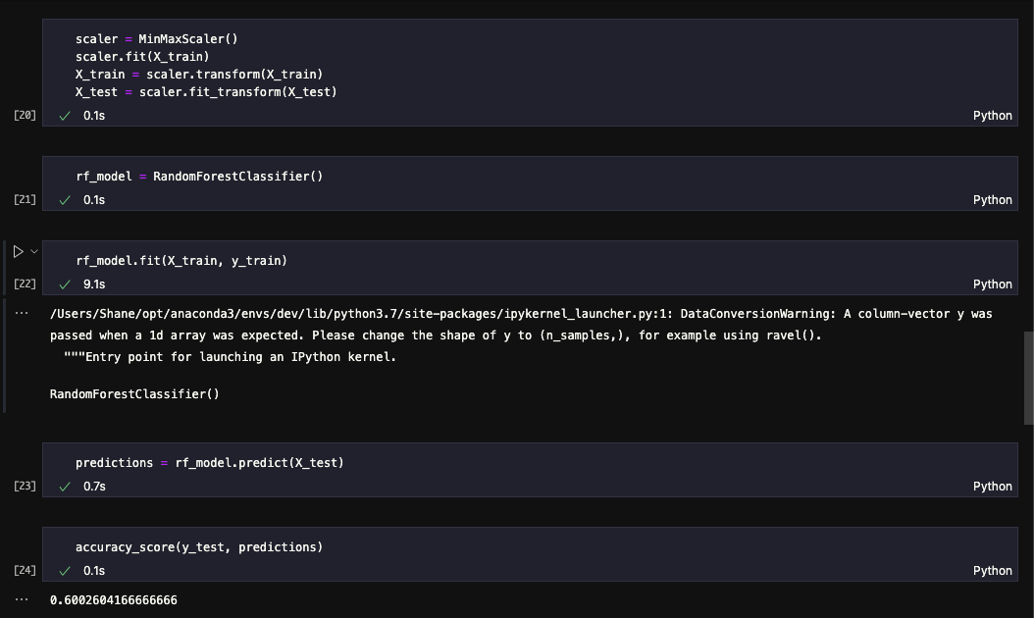
Machine Learning Models - NBA

Slide 7
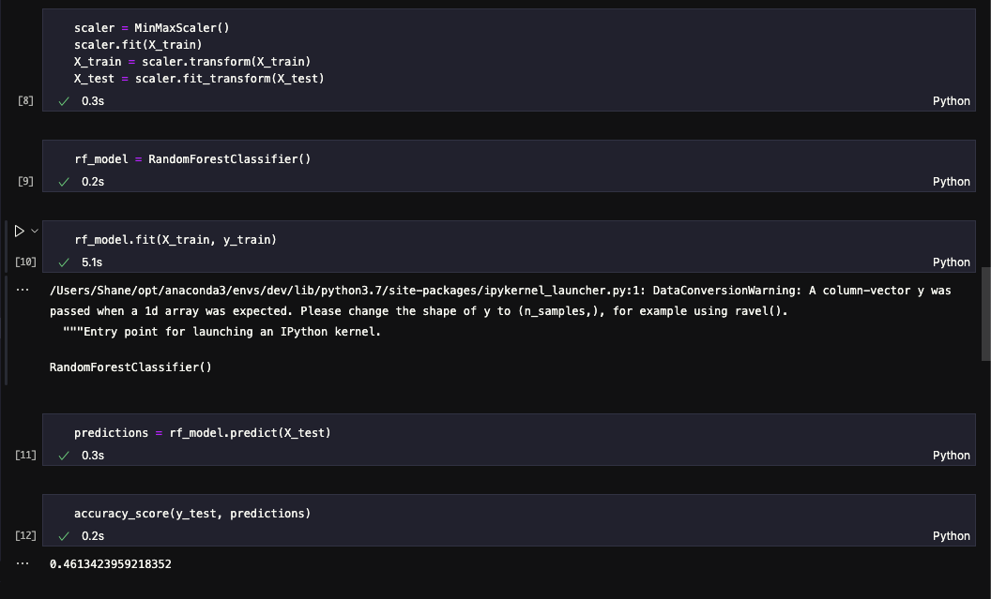
Machine Learning Models - EPL
For EPL, a neural network and RandomForest Model was used

Slide 8
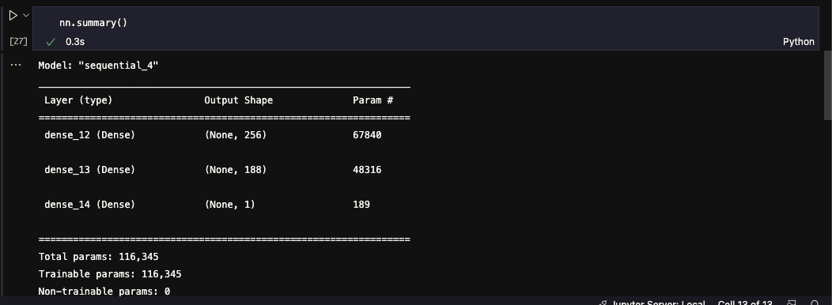
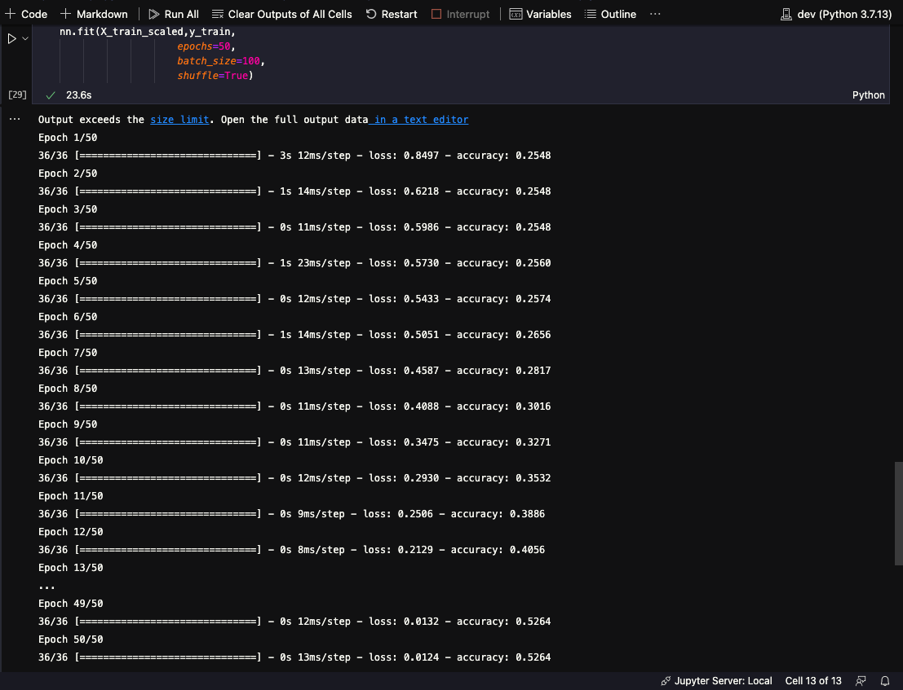
Machine Learning Models - EPL

Slide 9
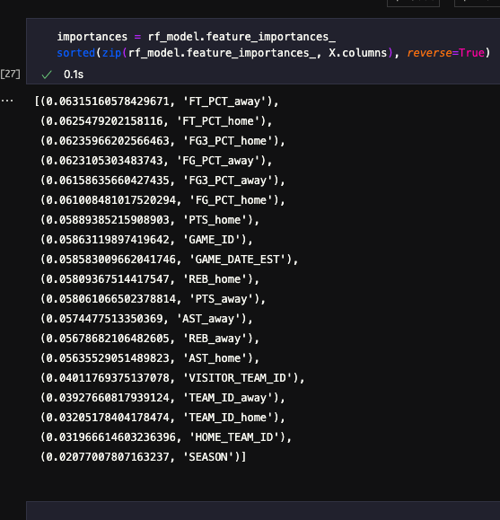
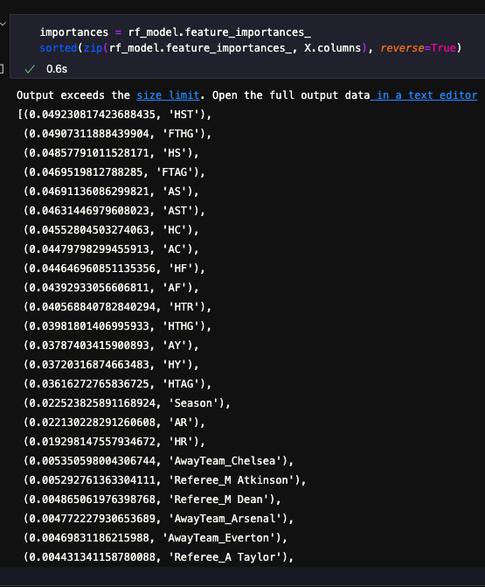
Feature Importance

Slide 10
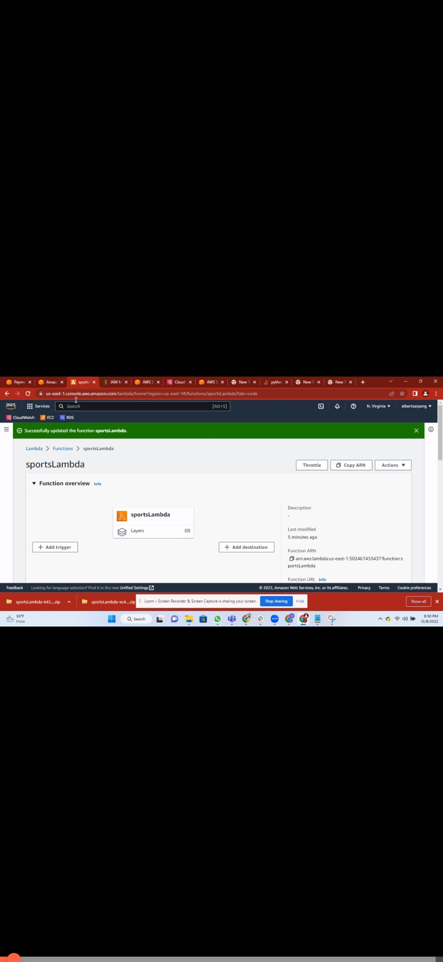
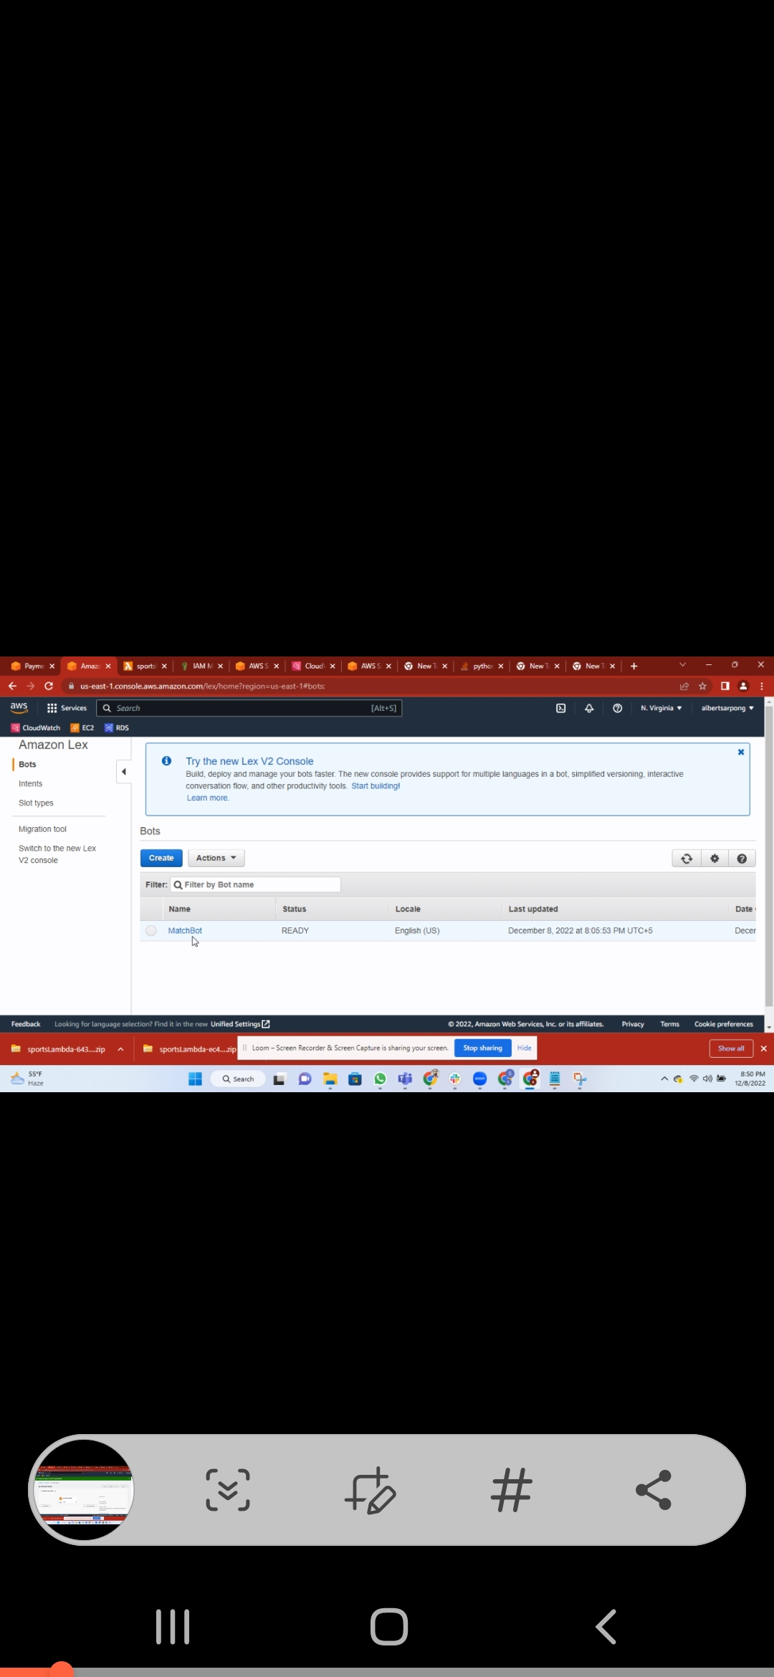
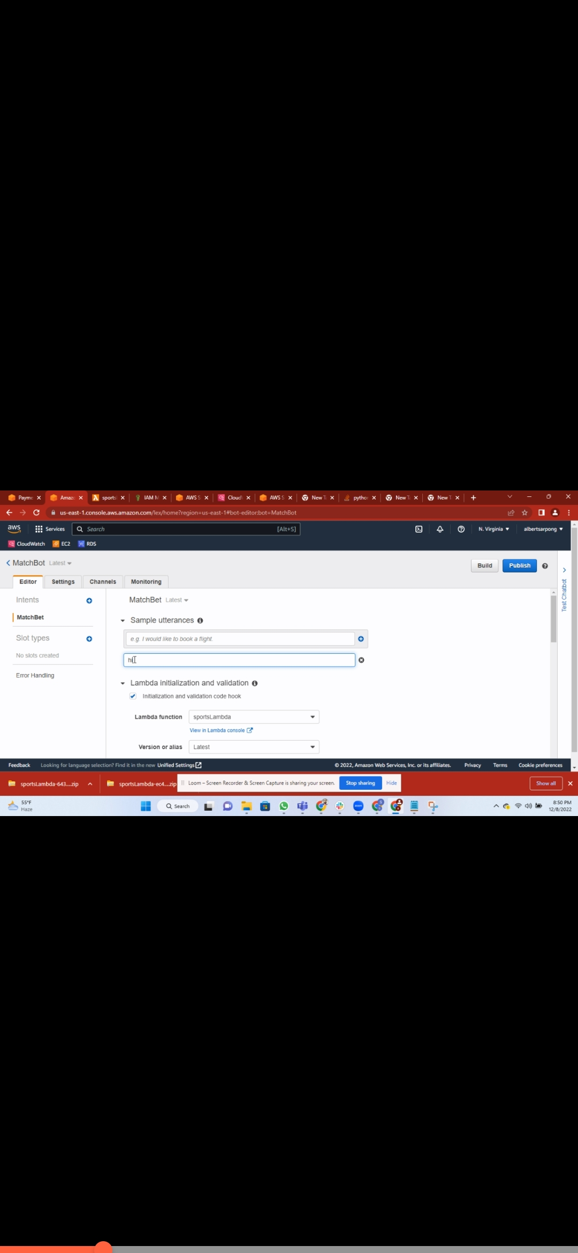
The Accubet Bot - AWS

Slide 11
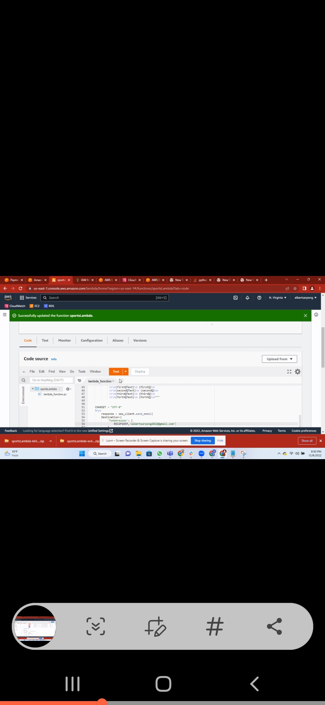
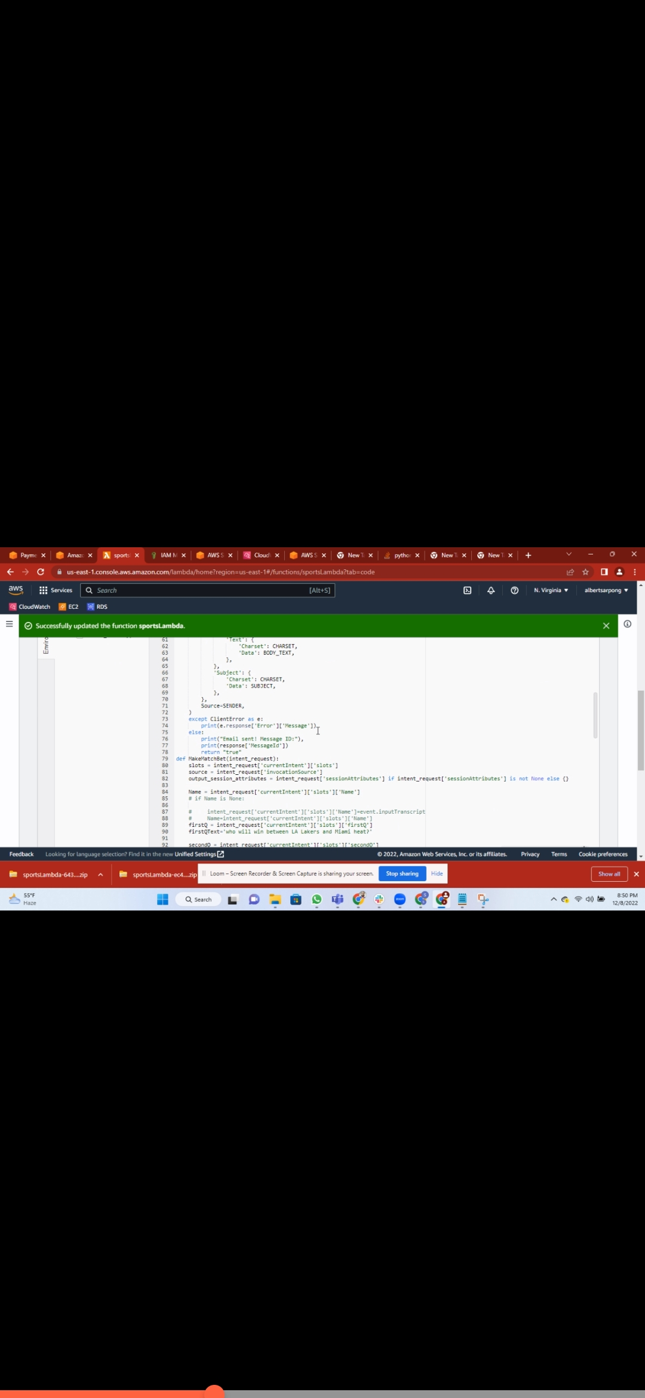
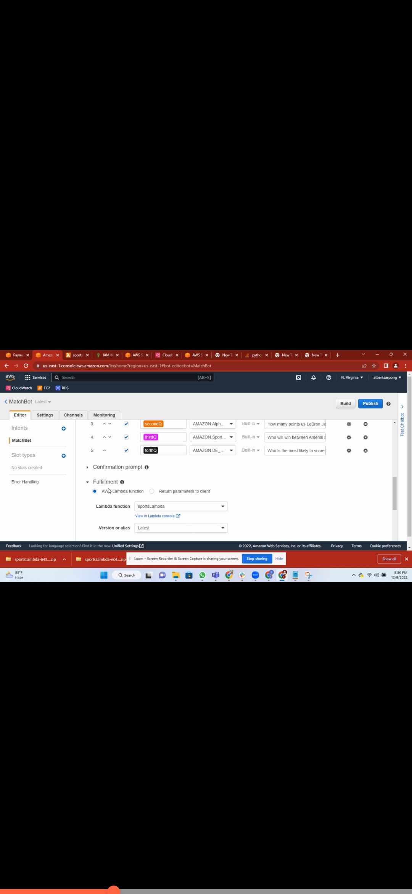
The Coding behind the bot

Slide 12
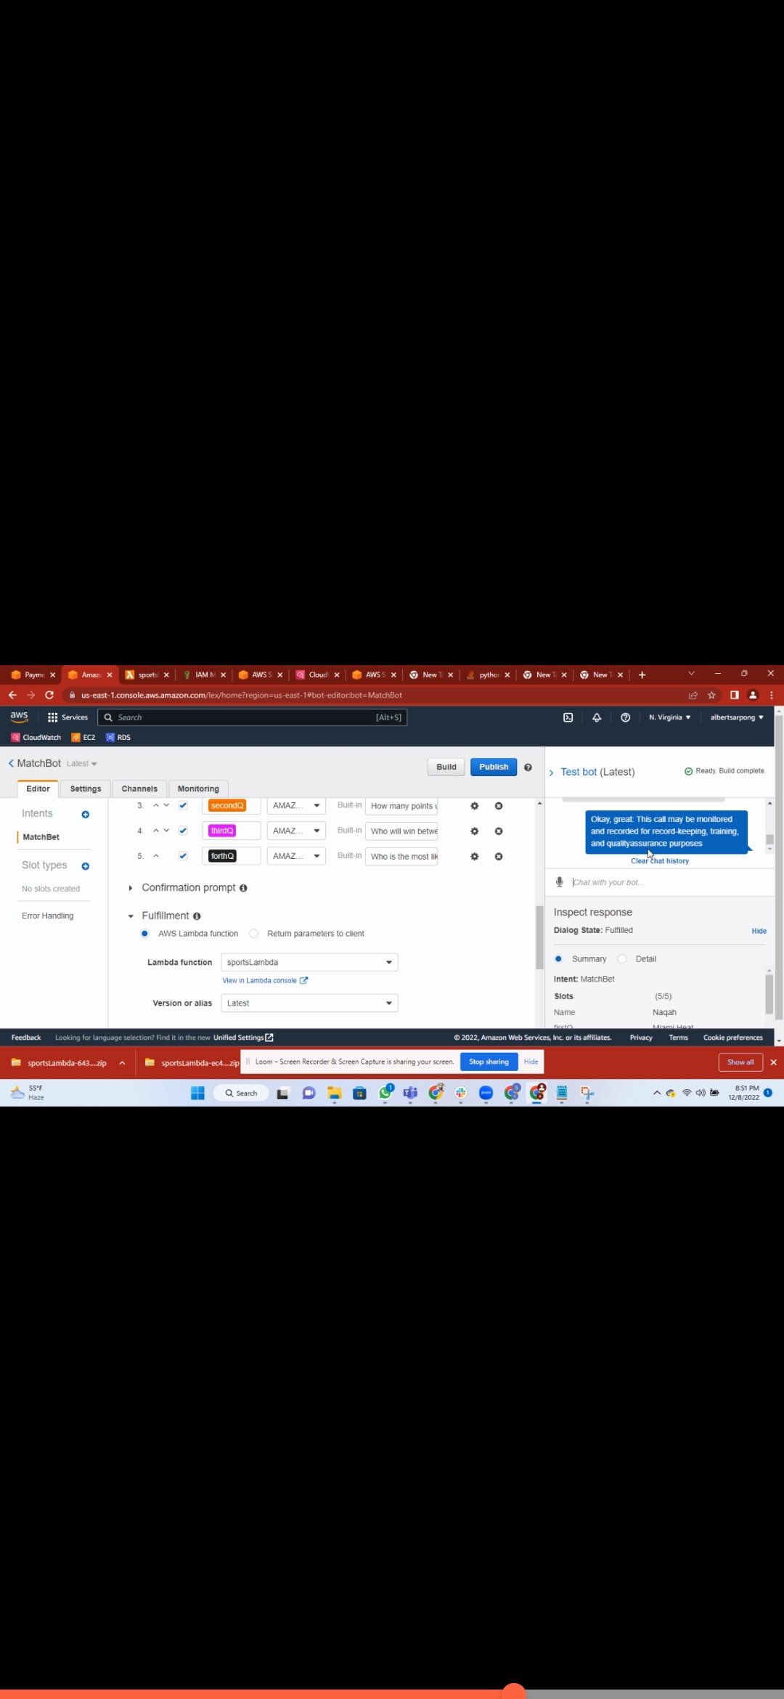
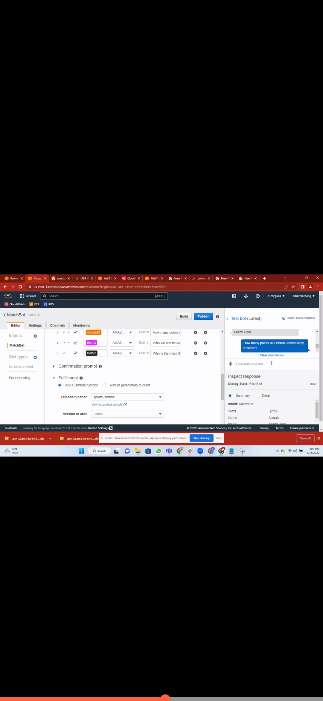
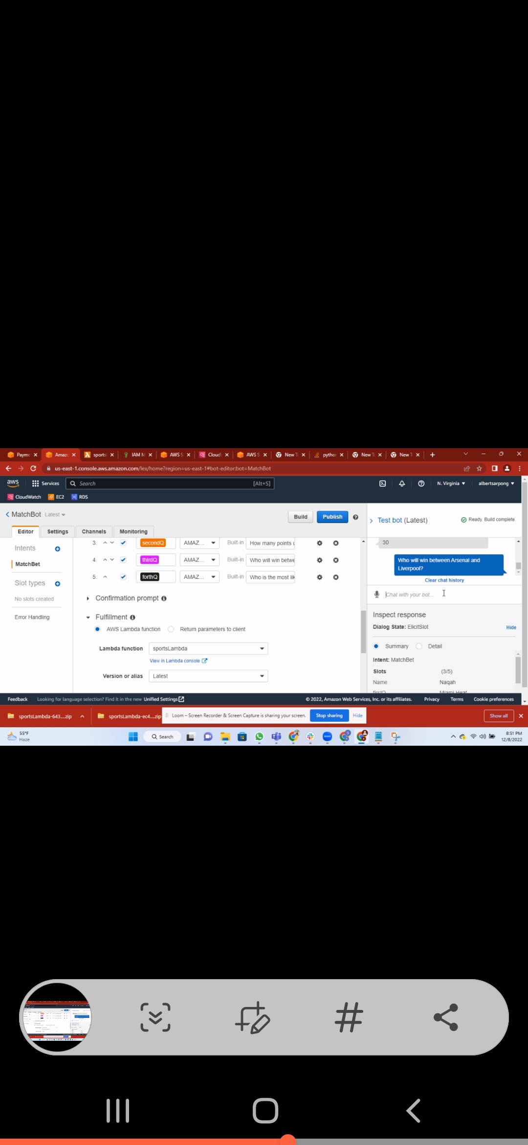
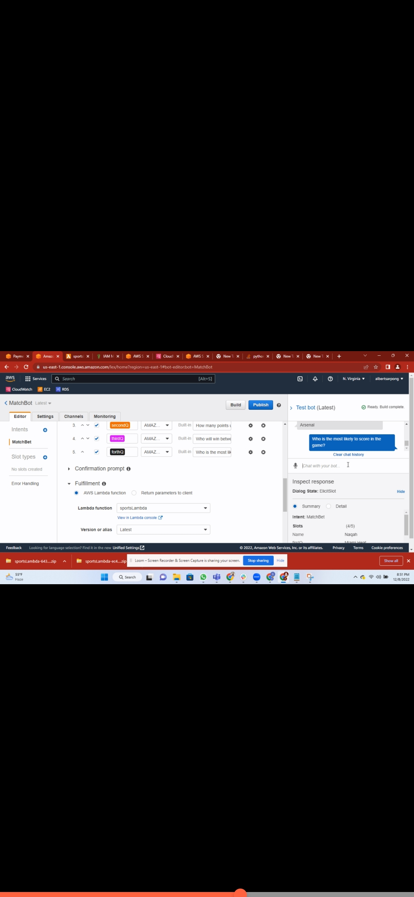
The Figuration of the Bot

Slide 13
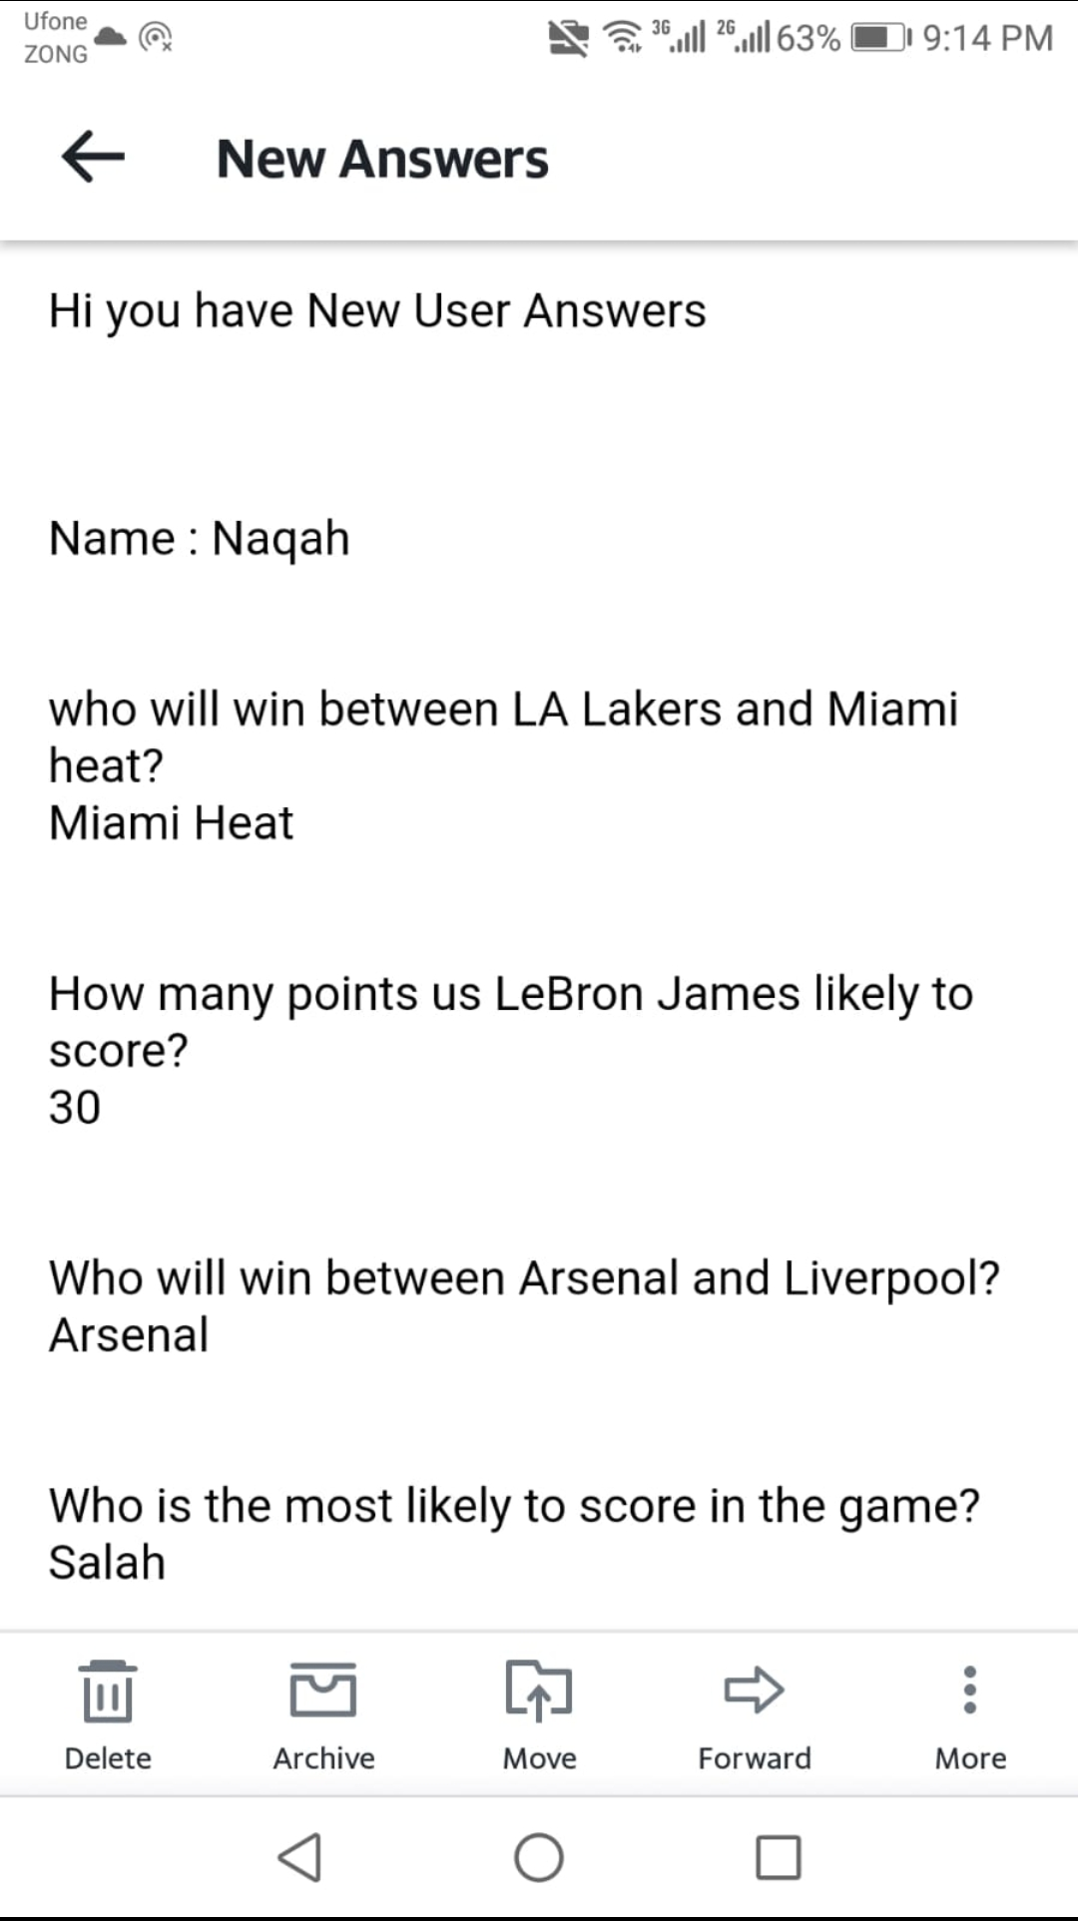

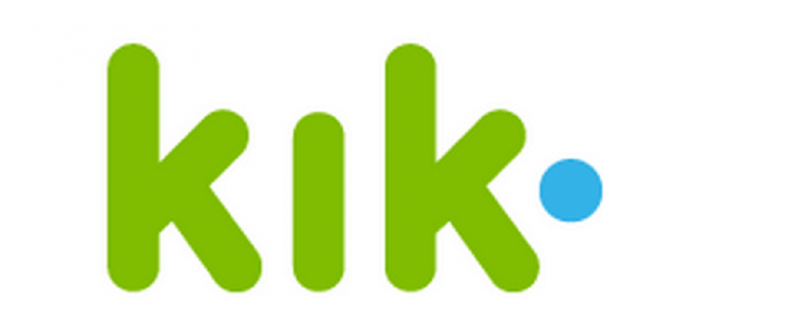

What the bot/ app entails and its social media adaptations

Slide 14
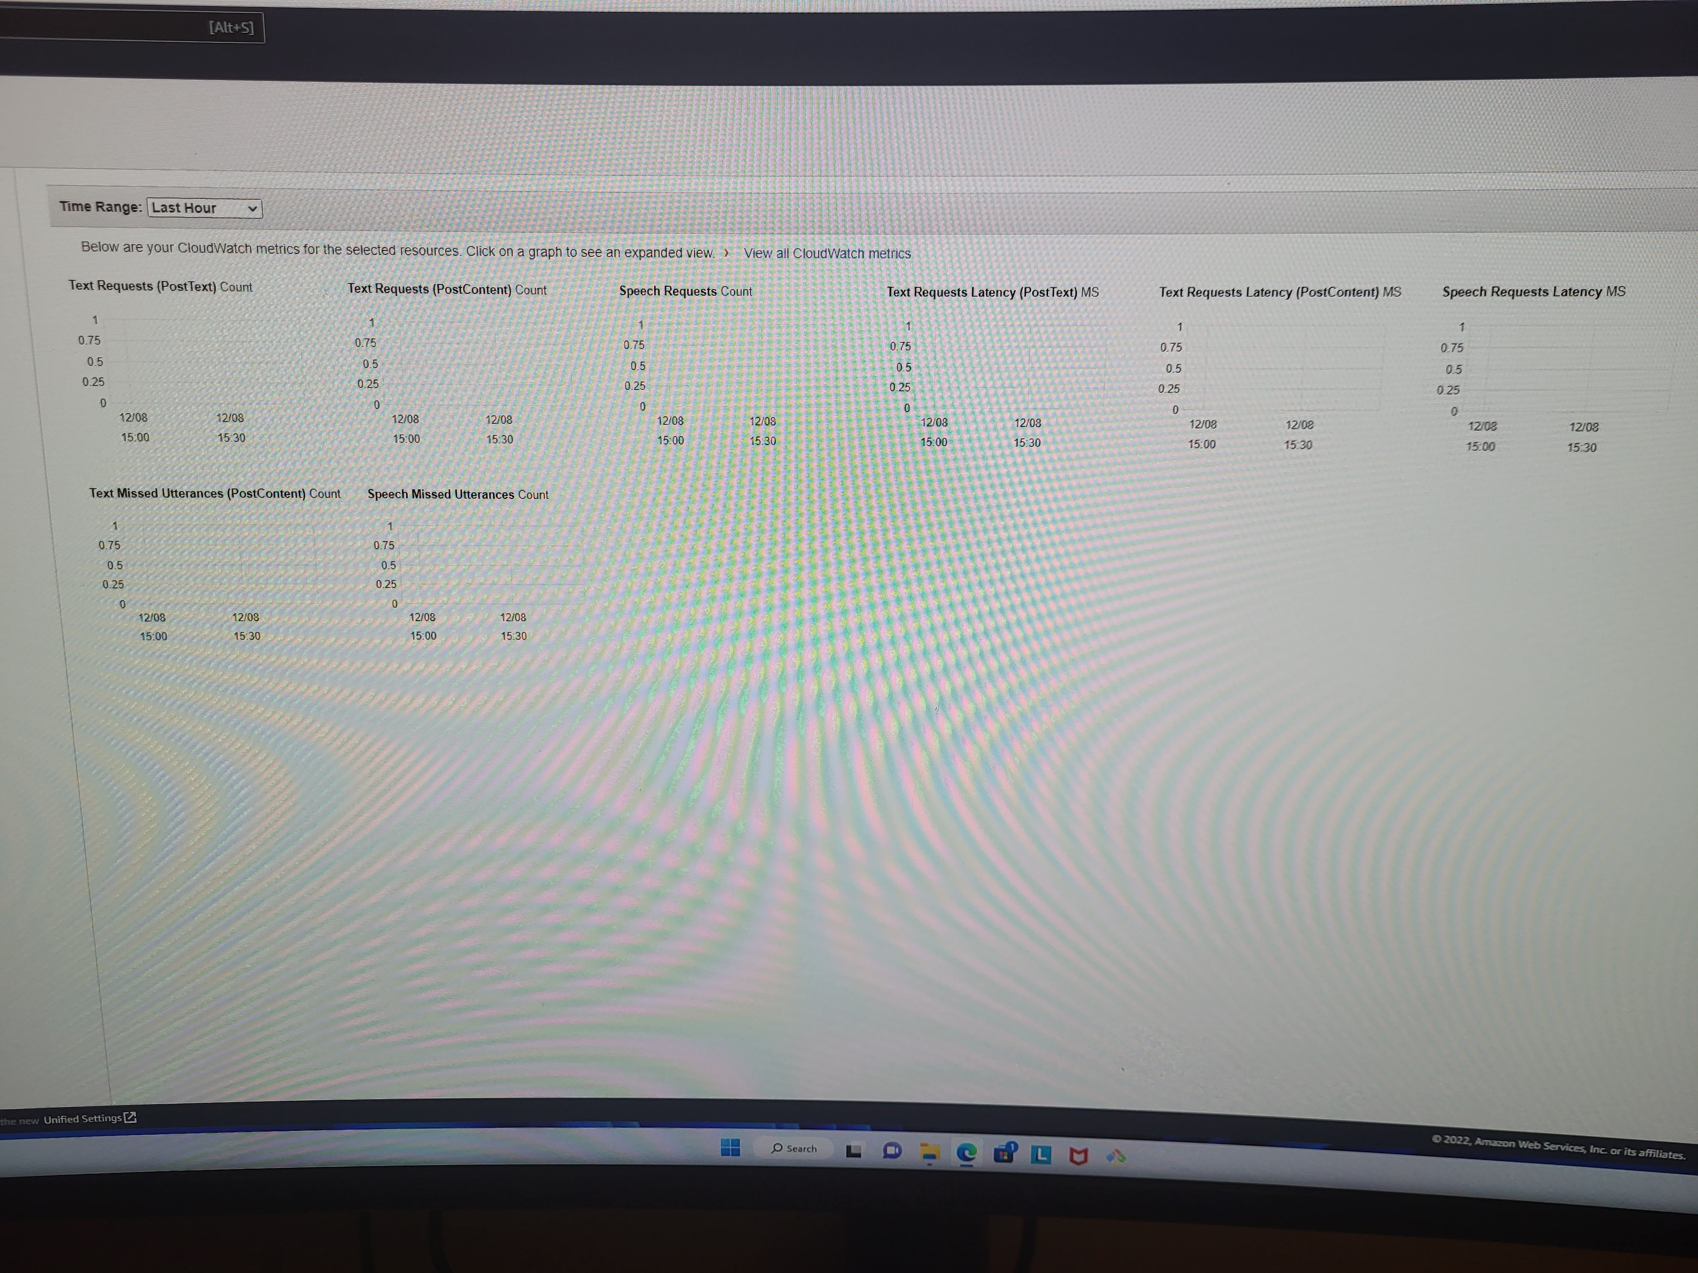
What the app / bot entails continued
Coversational Logs
Tables
Monitoring Graphs

Slide 15
What will happen next ?
Pyspark
In other words, PySpark is a Python API for Apache Spark. Apache Spark is an analytical processing engine for large scale powerful distributed data processing and machine learning applications.
PySpark is a general-purpose, in-memory, distributed processing engine that allows you to process data efficiently in a distributed fashion.
Applications running on PySpark are 100x faster than traditional systems.
You will get great benefits using PySpark for data ingestion pipelines.
Using PySpark we can process data from Hadoop HDFS, AWS S3, and many file systems.
PySpark also is used to process real-time data using Streaming and Kafka.
Using PySpark streaming you can also stream files from the file system and also stream from the socket.
PySpark natively has machine learning and graph libraries

Slide 16
Conclusion
This is the start of a business where users will use our site make accurate predictions (AccuBet)
When enough users use it, we will have enough web traffic to generate advertising revenue
The combination of AWS and ML models are extremely useful tools for everything we have done

